Slide 2
Topics
Procedural and Object-Oriented Programming
Classes
Working with Instances
Techniques for Designing Classes

Slide 3
Procedural Programming
Procedural programming: writing programs made of functions that perform specific tasks
  Procedures typically operate on data items that are separate from the procedures
  Data items commonly passed from one procedure to another
  Focus: to create procedures that operate on the program’s data
The separation of data and the code that operates on the data can lead to problems, however, as the program becomes larger and more complex.

Slide 4
Object-Oriented Programming
Object-oriented programming: focused on creating objects
Object: entity that contains data and procedures
  Data is known as data attributes and procedures are known as methods
    Methods perform operations on the data attributes

Slide 5
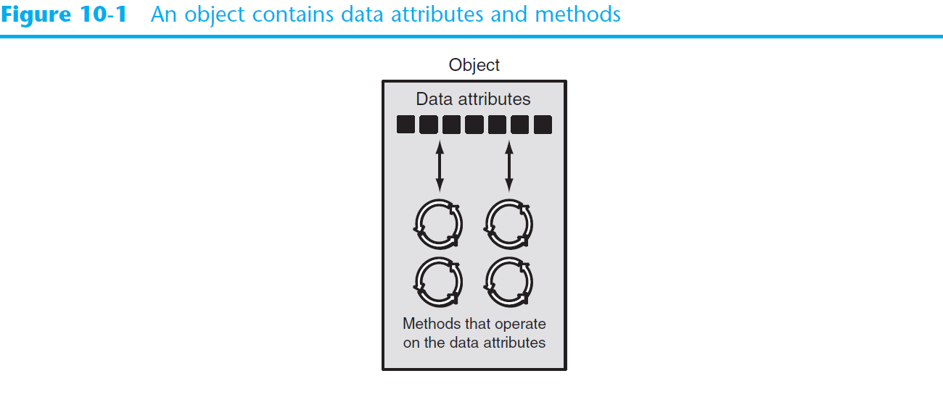
Object-Oriented Programming (cont’d.)
The object is, conceptually, a self-contained unit that consists of data attributes and methods that operate on the data attributes.

Slide 6
Object-Oriented Programming (cont’d.)
OOP addresses the problem of code and data separation through encapsulation and data hiding.
Encapsulation refers to the combining of data and code into a single object.
Data hiding refers to an object’s ability to hide its data attributes from code that is outside the object.
Only the object’s methods may directly access and make changes to the object’s data attributes.
An object typically hides its data but allows outside code to access its methods.

Slide 7
Object-Oriented Programming (cont’d.)
Another benefit of OOP is Object reusability.
  The same object can be used in different programs.
  Example: you can use the existing date class to print today’s date.
from datetime import date
today = date.today()
print(today) # 2023-03-20

Slide 8
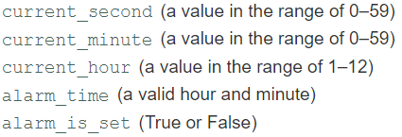
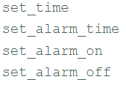
An Example of an Object
Imagine that your alarm clock is actually a software object. Then the following would be its data attributes:
The following are some of the alarm clock object’s public methods:

Slide 9
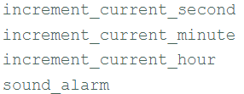
An Example of an Object
The following are some of the alarm clock object’s private methods which are part of the object’s private, internal workings.
External entities (such as you, the user of the alarm clock) do not have direct access to the alarm clock’s private methods.
The object is designed to execute these methods automatically and hide the details from you.

Slide 10
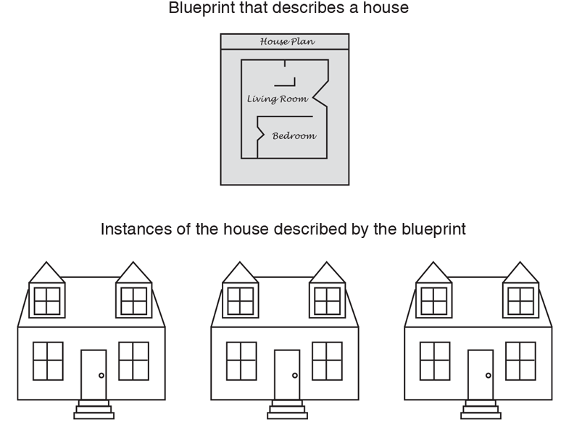
Classes
A class is a code that specifies the data attributes and methods of a particular type of object
  Similar to a blueprint of a house

Slide 11
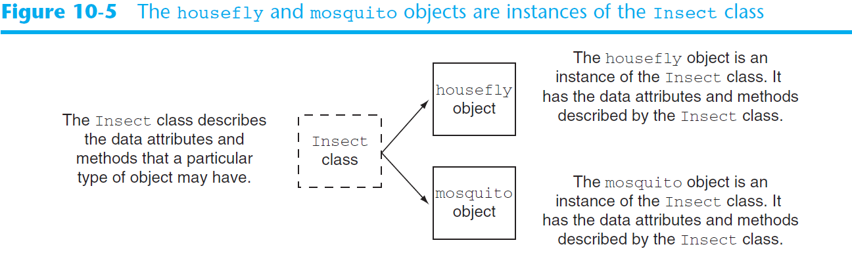
Classes
So, a class is a description of an object’s characteristics.
When the program is running, it can use the class to create, in memory, as many objects of a specific type as needed.
Each object that is created from a class is called an instance of the class.

Slide 12
Class Definitions
To create a class, you write a class definition.
A class definition is a set of statements that define a class’s methods and data attributes.
Format: begin with class Class_name:
  A general convention is to start the class name with uppercase letter
Method definition is like any other python function definition
  Example: def setEmail(self, email):
  self parameter: required in every method in the class
  references the specific object that the method is working on

Slide 13
Class Definitions
Most Python classes have an Initializer method which is automatically executed when an instance of the class is created.
  Initializes object’s data attributes and assigns self parameter to the object that was just created
  Format: def __init__ (self):
  Usually, the first method in a class definition

Slide 14
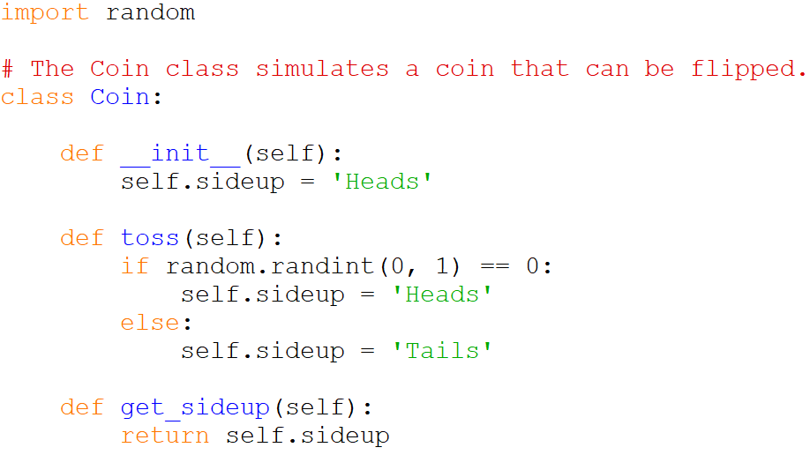
Class Definitions

Slide 15
Class Definitions
To create a new instance of a class
  Format: variable_name = ClassName()
Example:
The expression Coin() above causes two things to happen
  An object is created in memory from the Coin class.
  The Coin class’s _ _init_ _ method is executed, and the self parameter is automatically set to the object that was just created. As a result, that object’s sideup attribute is assigned the string 'Heads'
my_coin = Coin()

Slide 16
Class Definitions
To call any of the class methods using the created instance, use dot notation
  Format: My_instance.method()
  Example: my_coin.toss()
  Notice we did not have to pass an argument to the toss method, despite the fact that it has the self parameter variable.
  When a method is called, Python automatically passes a reference to the calling object into the method’s first parameter.
  As a result, the self parameter will automatically reference the object on which the method is to operate.

Slide 17
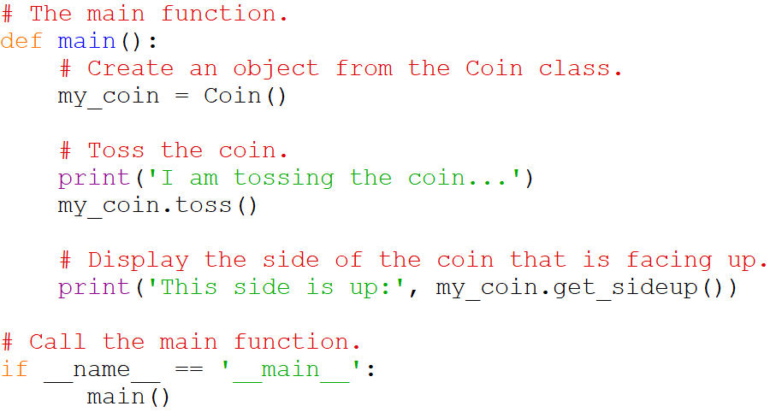
Class Definitions

Slide 18
Complete Code
import random
# The Coin class simulates a coin that can be flipped.
class Coin:
def __init__(self):
self.sideup = 'Heads'
def toss(self):
if random.randint(0, 1) == 0:
self.sideup = 'Heads'
else:
self.sideup = 'Tails'
def get_sideup(self):
return self.sideup
# The main function.
def main():
# Create an object from the Coin class.
my_coin = Coin()
# Toss the coin.
print('I am tossing the coin...')
my_coin.toss()
# Display the side of the coin that is facing up.
print('This side is up:', my_coin.get_sideup())
# Call the main function.
if __name__ == '__main__':
main()

Slide 19
Hiding Attributes
An object’s data attributes should be private so that only the object’s methods can directly access them.
This protects the object’s data attributes from accidental corruption.
However, in the Coin class that was shown in the previous example, the sideup attribute is not private.
It can be directly accessed by statements that are not in a Coin class method such as from the main method.
  my_coin.sideup = ‘Heads’
  One can easily write the above statement in the main method and directly change the value of sideup without the toss.
In Python, you can make an attribute private by starting its name with two underscore characters. If we change the name of the sideup attribute to _ _sideup, it becomes private to the Coin class.

Slide 20
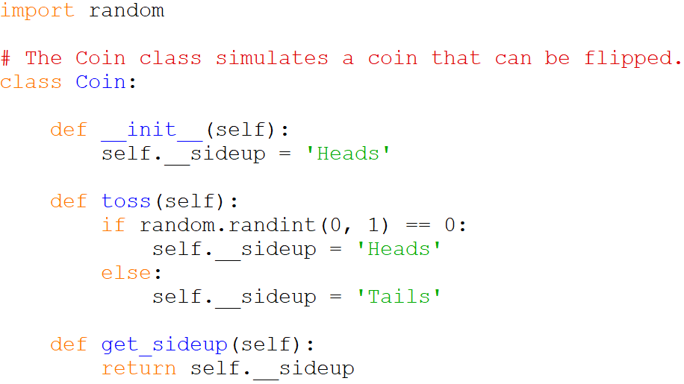
Hiding Attributes

Slide 21
Entire Code
import random
# The Coin class simulates a coin that can be flipped.
class Coin:
def __init__(self):
self.__sideup = 'Heads'
def toss(self):
if random.randint(0, 1) == 0:
self.__sideup = 'Heads'
else:
self.__sideup = 'Tails'
def get_sideup(self):
return self.__sideup
# The main function.
def main():
# Create an object from the Coin class.
my_coin = Coin()
# Toss the coin 10 times.
print('I am going to toss the coin ten times:')
for count in range(10):
my_coin.toss()
print(my_coin.get_sideup())
# Call the main function.
if __name__ == '__main__':
main()

Slide 22
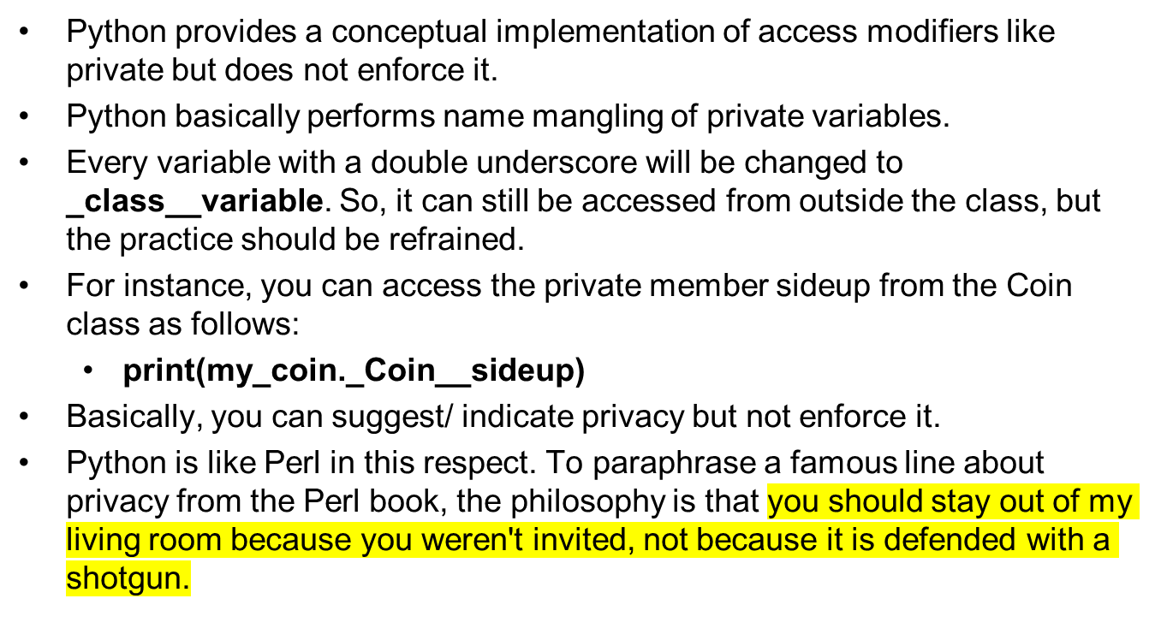
Note on Privacy in Python

Slide 23
Storing Classes in Modules
The Coin class definition is in the same file as the programming statements that use the Coin class (i.e., the main method).
This approach works fine with small programs that use only one or two classes.
As programs use more classes, however, the need to organize those classes becomes greater.
Programmers commonly organize their class definitions by storing them in modules.
Then the modules can be imported into any programs that need to use the classes they contain.
Next, we will store the Coin class in a module named ‘classes’ and then import this module to use in the main method.

Slide 24
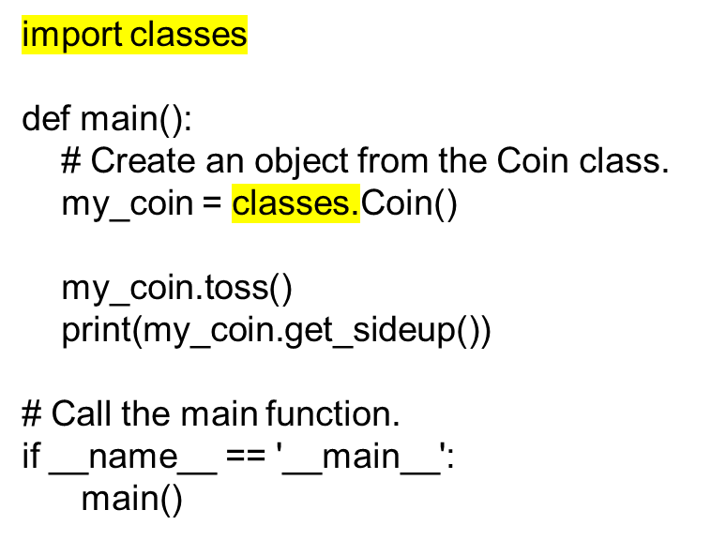
Storing Classes in Modules
Save the Coin class in a module named ‘classes’ (filename will be classes.py)
Create a test.py file which has the main method that uses the Coin class.
  The only change is that you import the coin module and use the module name to create the object: classes.Coin()

Slide 25
The BankAccount Class
Let’s design a BankAccount class.
Objects that are created from this class will simulate bank accounts, allowing us to have a starting balance, make deposits, make withdrawals, and get the current balance.

Slide 26
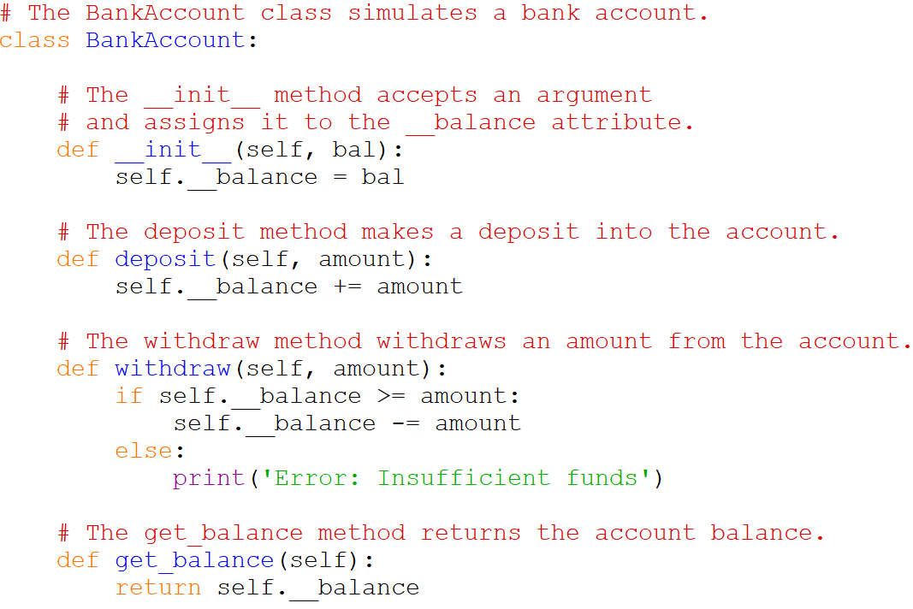
The BankAccount Class

Slide 27
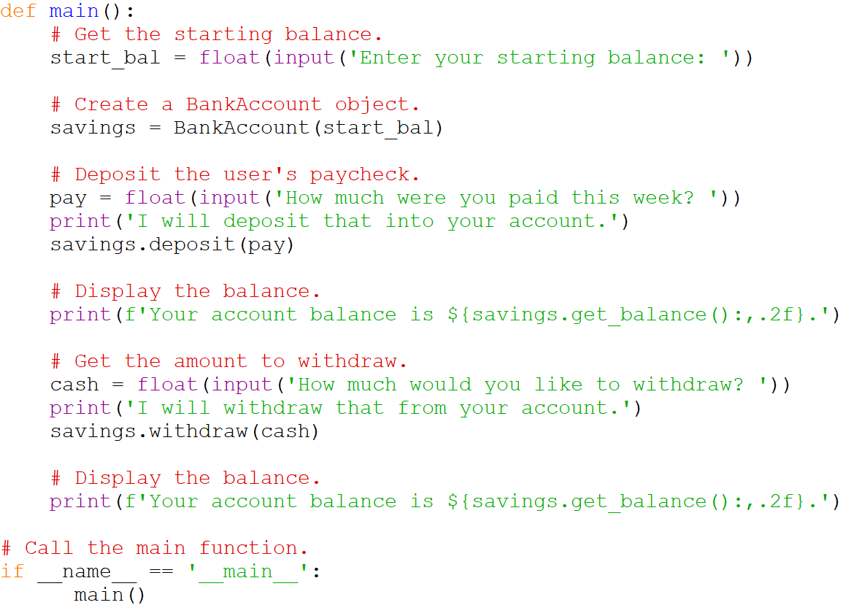
The BankAccount Class

Slide 28
The BankAccount Class – Entire Code
# The BankAccount class simulates a bank account.
class BankAccount:
# The __init__ method accepts an argument
# and assigns it to the __balance attribute.
def __init__(self, bal):
self.__balance = bal
# The deposit method makes a deposit into the account.
def deposit(self, amount):
self.__balance += amount
# The withdraw method withdraws an amount from the account.
def withdraw(self, amount):
if self.__balance >= amount:
self.__balance -= amount
else:
print('Error: Insufficient funds')
# The get_balance method returns the account balance.
def get_balance(self):
return self.__balance
def main():
# Get the starting balance.
start_bal = float(input('Enter your starting balance: '))
# Create a BankAccount object.
savings = BankAccount(start_bal)
# Deposit the user's paycheck.
pay = float(input('How much were you paid this week? '))
print('I will deposit that into your account.')
savings.deposit(pay)
# Display the balance.
print(f'Your account balance is ${savings.get_balance():,.2f}.')
# Get the amount to withdraw.
cash = float(input('How much would you like to withdraw? '))
print('I will withdraw that from your account.')
savings.withdraw(cash)
# Display the balance.
print(f'Your account balance is ${savings.get_balance():,.2f}.')
# Call the main function.
if __name__ == '__main__':
main()

Slide 29
The __str__ method
Quite often, we need to display a message that indicates an object’s state.
An object’s state is simply the values of the object’s attributes at any given moment.
For example, in case of the BankAccount class, the value of the _ _balance attribute represents the object’s state at any given moment.
You can call the get_balance() method to get the balance.
However, displaying an object’s state is so common that many programmers equip their classes with a method that returns a string containing the object’s state.
In Python, you give this method the special name _ _str _ _.

Slide 30
The __str__ method
You can add a _ _str _ _ method to the BankAccount class as shown below:
In the main method, when you pass a BankAccount object to the print function, the _ _str _ _ method is automatically called.
  savings = BankAccount(100)
  print(savings)
  The above print function calls the _ _str _ _ method automatically.
# The __str__ method returns a string
# indicating the object's state.
def __str__(self):
return f'The balance is ${self.__balance:,.2f}'

Slide 31
The __str__ method – Complete Code
# The BankAccount class simulates a bank account.
class BankAccount:
# The __init__ method accepts an argument
# and assigns it to the __balance attribute.
def __init__(self, bal):
self.__balance = bal
# The deposit method makes a deposit into the account.
def deposit(self, amount):
self.__balance += amount
# The withdraw method withdraws an amount from the account.
def withdraw(self, amount):
if self.__balance >= amount:
self.__balance -= amount
else:
print('Error: Insufficient funds')
# The get_balance method returns the account balance.
def get_balance(self):
return self.__balance
# The __str__ method returns a string
# indicating the object's state.
def __str__(self):
return f'The balance is ${self.__balance:,.2f}'
def main():
# Create a BankAccount object.
savings = BankAccount(200)
# Display the balance using __str__() function.
print(savings)
# Display the balance using get_balance() function.
print(f'The balance is ${savings.get_balance():,.2f}.')
# Call the main function.
if __name__ == '__main__':
main()

Slide 32
Working With Instances
You can create multiple instances/ objects of a class and each instance has its own set of attributes.
For example, if we create two instances of the BankAccount class, say, savings1 and savings2, each will have its own copy of balance attribute.

Slide 33
Accessor and Mutator Methods
Typically, all of a class’s data attributes are private and provide methods to access and change them
Accessor methods: return a value from a class’s attribute without changing it
  Safe way for code outside the class to retrieve the value of attributes
Mutator methods: store or change the value of a data attribute
  If necessary, the mutator can validate the value before it assigns it to the data attribute.

Slide 34
Passing Objects as Arguments
Methods and functions often need to accept objects as arguments.
When you pass an object as an argument, you are actually passing a reference to the object
  The receiving method or function has access to the actual object.
In the next example, the flip function has access to the actual object and its attributes and methods.

Slide 35
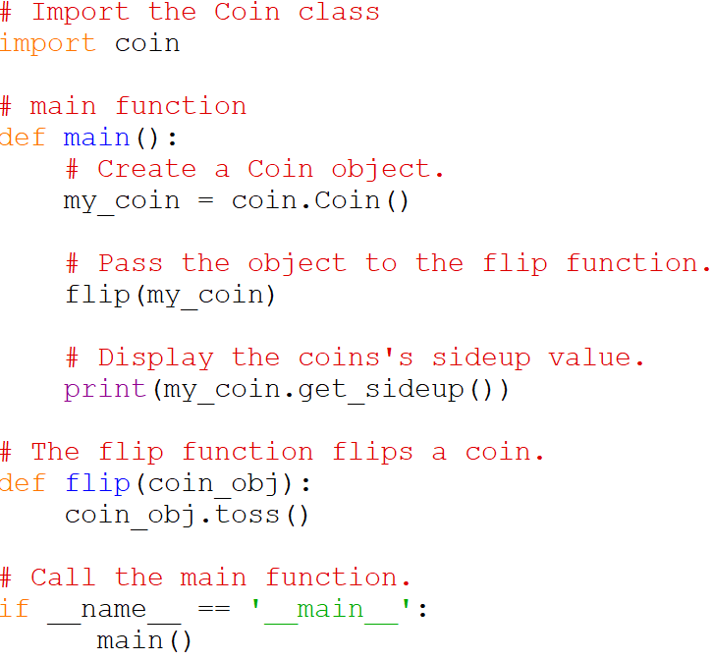
Passing Objects as Arguments

Slide 36
Passing Objects as Arguments – Entire Code
import random
# The Coin class simulates a coin that can be flipped.
class Coin:
def __init__(self):
self.__sideup = 'Heads'
def toss(self):
if random.randint(0, 1) == 0:
self.__sideup = 'Heads'
else:
self.__sideup = 'Tails'
def get_sideup(self):
return self.__sideup
# Import the Coin class
import coin
# main function
def main():
# Create a Coin object.
my_coin = coin.Coin()
# Pass the object to the flip function.
flip(my_coin)
# Display the coins's sideup value.
print(my_coin.get_sideup())
# The flip function flips a coin.
def flip(coin_obj):
coin_obj.toss()
# Call the main function.
if __name__ == '__main__':
main()

Slide 37
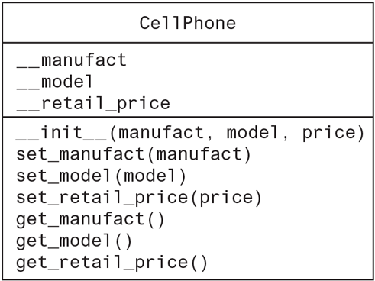
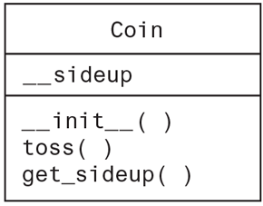
UML Class Diagrams
UML stands for Unified Modeling Language and provides a set of standard diagrams for graphically depicting object-oriented systems.
When designing a class, it is often helpful to draw a UML Class diagram which consists of a box divided into three sections which include the class name, data attributes and a list of methods.

Slide 38
UML Class Diagrams
Suppose we are writing a program that the manager of Joe’s Automotive Shop will use to print service quotes for customers. Here is a description:
Joe’s Automotive Shop services foreign cars and specializes in servicing cars made by Mercedes, Porsche, and BMW. When a customer brings a car to the shop, the manager gets the customer’s name, address, and telephone number. The manager then determines the make, model, and year of the car and gives the customer a service quote. The service quote shows the estimated parts charges, estimated labor charges, sales tax, and total estimated charges.
Based on this description of a problem domain, identify the classes and design the UML diagrams for them.

Slide 39
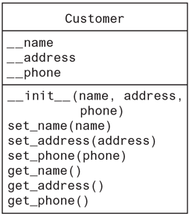
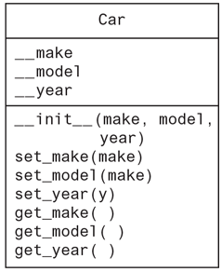
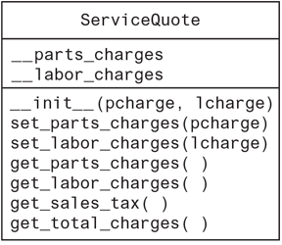
UML Class Diagrams

Slide 40
UML Class Diagrams
Write the Python code for the classes based on these UML Class diagrams.

Slide 41
Customer Class
# Customer class
class Customer:
def __init__(self, name, address, phone):
self.__name = name
self.__address = address
self.__phone = phone
def set_name(self, name):
self.__name = name
def set_address(self, address):
self.__address = address
def set_phone(self, phone):
self.__phone = phone
def get_name(self):
return self.__name
def get_address(self):
return self.__address
def get_phone(self):
return self.__phone

Slide 42
Car Class
# Car class
class Car:
def __init__(self, make, model, year):
self.__make = make
self.__model = model
self.__year = year
def set_make(self, make):
self.__make = make
def set_model(self, model):
self.__model = model
def set_year(self, year):
self.__year = year
def get_make(self):
return self.__make
def get_model(self):
return self.__model
def get_year(self):
return self.__year

Slide 43
Service Quote Class
# Constant for the sales tax rate
TAX_RATE = 0.05
# ServiceQuote class
class ServiceQuote:
def __init__(self, pcharge, lcharge):
self.__parts_charges = pcharge
self.__labor_charges = lcharge
def set_parts_charges(self, pcharge):
self.__parts_charges = pcharge
def set_labor_charges(self, lcharge):
self.__labor_charges = lcharge
def get_parts_charges(self):
return self.__parts_charges
def get_labor_charges(self):
return self.__labor_charges
def get_sales_tax(self):
return self.__parts_charges * TAX_RATE
def get_total_charges(self):
return self.__parts_charges + self.__labor_charges + \
(self.__parts_charges * TAX_RATE)

Slide 44
The CellPhone Class
You have been asked to design a class that represents a cell phone. The data that should be kept as attributes in the class are as follows:
  The name of the phone’s manufacturer will be assigned to the _ _manufact attribute.
  The phone’s model number will be assigned to the _ _model attribute.
  The phone’s retail price will be assigned to the _ _retail_price attribute.
The class will also have the following methods:
  An _ _init_ _ method that accepts arguments for the manufacturer, model number, and retail price.
  A set_manufact method that accepts an argument for the manufacturer. This method will allow us to change the value of the _ _manufact attribute after the object has been created, if necessary.
  A set_model method that accepts an argument for the model. This method will allow us to change the value of the _ _model attribute after the object has been created, if necessary.
  A set_retail_price method that accepts an argument for the retail price. This method will allow us to change the value of the _ _retail_price attribute after the object has been created, if necessary.
  A get_manufact method that returns the phone’s manufacturer.
  A get_model method that returns the phone’s model number.
  A get_retail_price method that returns the phone’s retail price.

Slide 45
The CellPhone Class
# The CellPhone class holds data about a cell phone.
class CellPhone:
# The __init__ method initializes the attributes.
def __init__(self, manufact, model, price):
self.__manufact = manufact
self.__model = model
self.__retail_price = price
# The set_manufact method accepts an argument for
# the phone's manufacturer.
def set_manufact(self, manufact):
self.__manufact = manufact
# The set_model method accepts an argument for
# the phone's model number.
def set_model(self, model):
self.__model = model
# The set_retail_price method accepts an argument
# for the phone's retail price.
def set_retail_price(self, price):
self.__retail_price = price
# The get_manufact method returns the
# phone's manufacturer.
def get_manufact(self):
return self.__manufact
# The get_model method returns the
# phone's model number.
def get_model(self):
return self.__model
# The get_retail_price method returns the
# phone's retail price.
def get_retail_price(self):
return self.__retail_price

Slide 46
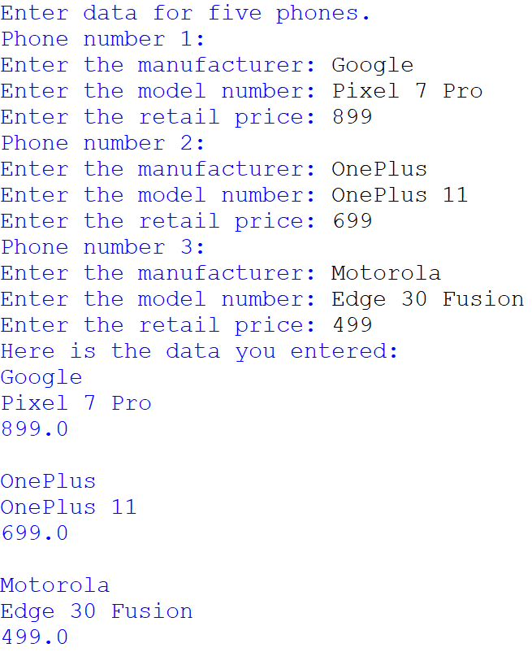
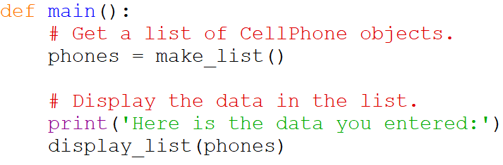
The CellPhone Class
Now, write a program that gets the data for three phones from the user, creates three CellPhone objects holding that data, and stores those objects in a list. It then iterates over the list displaying the attributes of each object.

Slide 47
Pickling your own Objects
The pickle module provides functions for serializing objects.
Serializing an object means converting it to a stream of bytes that can be saved to a file for later retrieval.
The pickle module’s dump function serializes (pickles) an object and writes it to a file, and the load function retrieves an object from a file and deserializes (unpickles) it.

Slide 48
Exercise
Write a program that will use the previously used cellphone class.
Your program will allow users to enter as many cellphone information as they want.
Your program will create cellphone objects from the user entered information and store all these objects individually in a file.
Your program will then read this file and display the values of all the cellphone objects that were read from the file.
See sample output next.

Slide 49
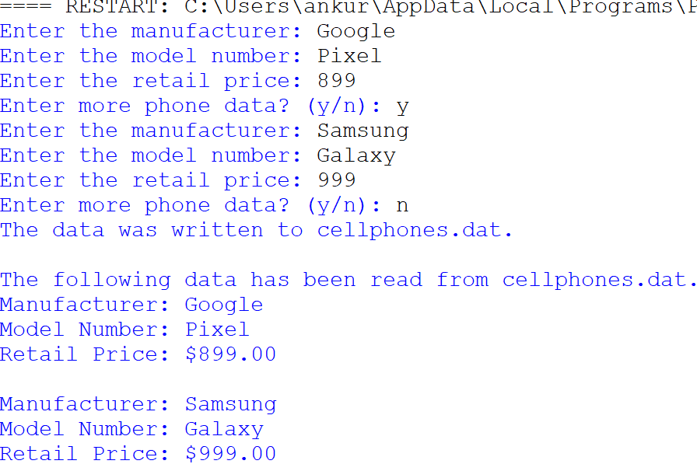
Exercise
Sample Output

Slide 50
Summary
This chapter covered:
  Procedural vs. object-oriented programming
  Classes and instances
  Class definitions, including:
    The self parameter
    Data attributes and methods including privacy
    __init__ and __str__ functions
  Storing classes in modules
  Designing classes and UML Class diagrams
  Pickling and Unpickling objects

